Slide 1






Stochastic response analysis and optimum design of nonlinear electromechanical energy harvesters: A Wiener path integral approach
Engineering Mechanics Institute Conference (EMI)
Boston, MA
May 29 – June 1, 2018
Ioannis Petromichelakis, Apostolos F. Psaros and Ioannis A. Kougioumtzoglou
Dept. of Civil Engineering & Engineering Mechanics
Columbia University, USA

Slide 2
Outline
Introduction
Vibration Energy Harvesting
Modelling aspects
Optimization
Wiener path integral (WPI) technique
Standard formulation
Modification
Numerical Results
Conclusions

Slide 3
Outline
Introduction
Vibration Energy Harvesting
Modelling aspects
Optimization
Wiener path integral (WPI) technique
Standard formulation
Modification
Numerical Results
Conclusions

Slide 4
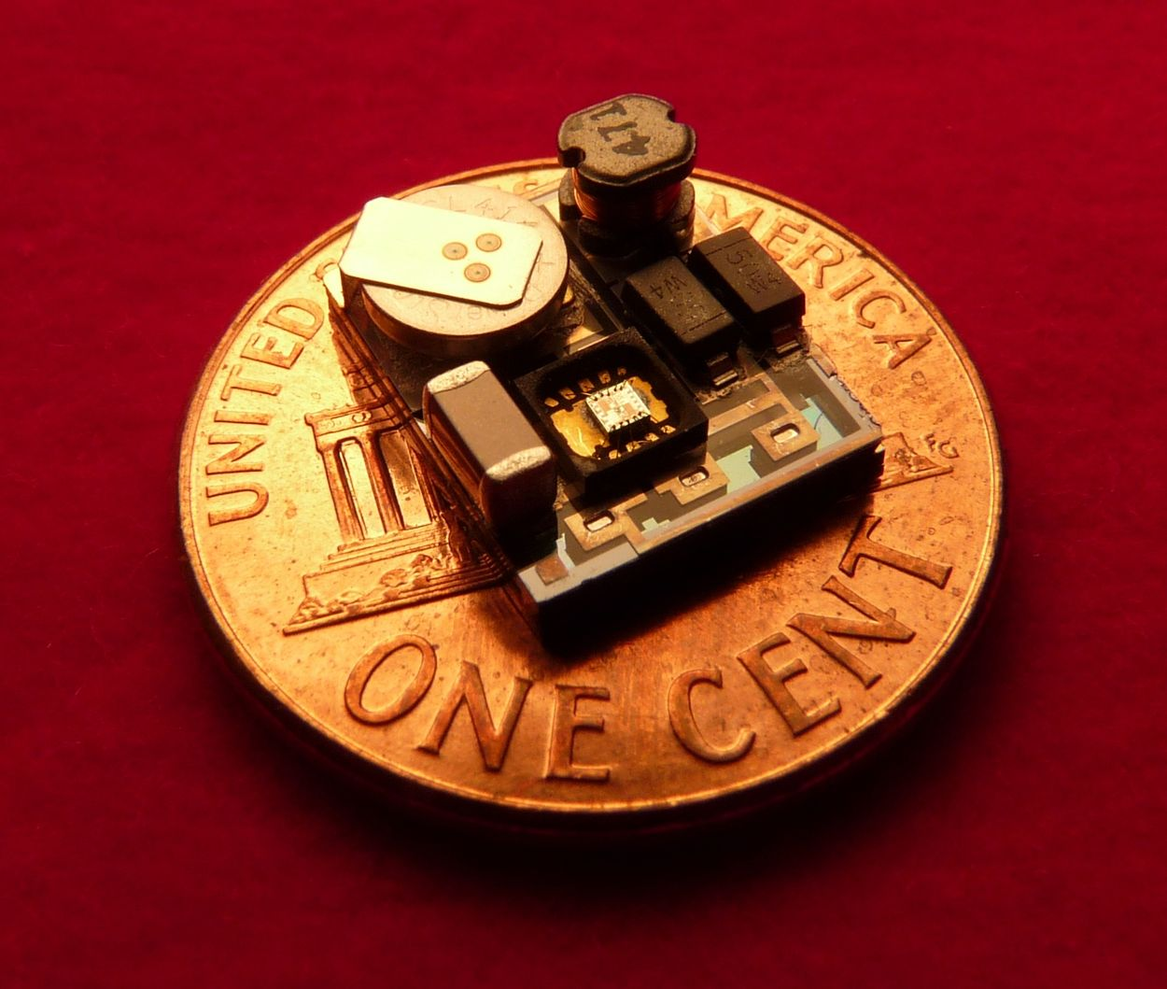

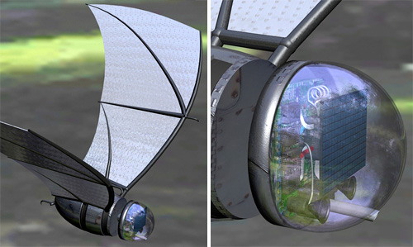



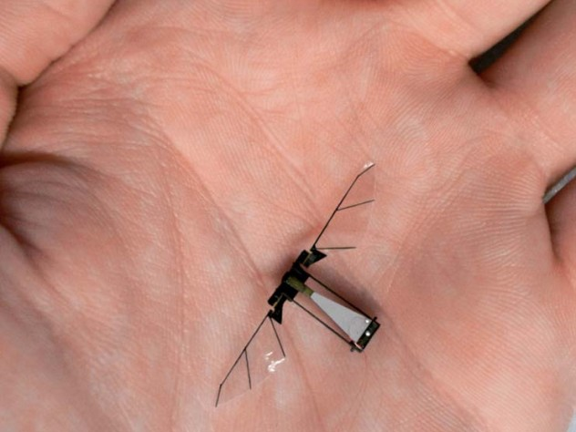

Introduction
Vibration energy harvesting technology
Potential applications
Micro-robotic applications and powering of biomedical implants
Wireless sensors networks for Structural Health Monitoring

Slide 5
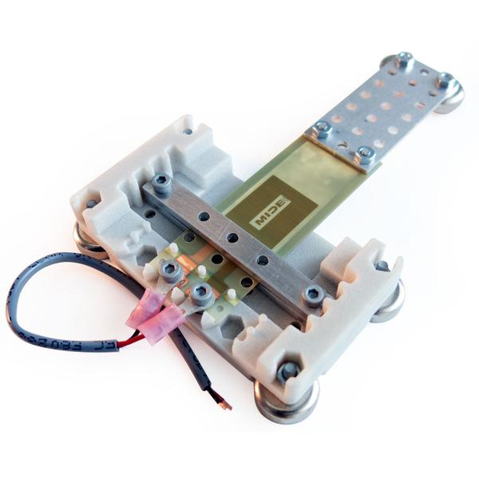
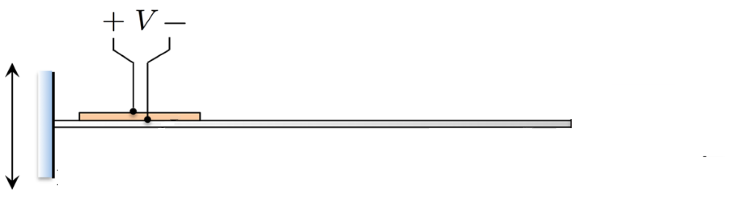
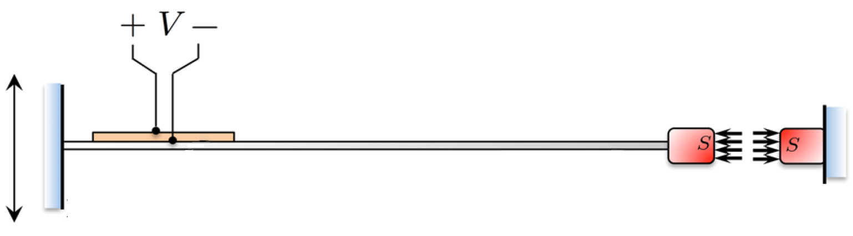
Introduction
Linear energy harvester
Piezoelectric patch
Beam
Nonlinear energy harvester
Magnets
What if?
More realistic approach: stochastic process

Slide 6
Outline
Introduction
Vibration Energy Harvesting
Modelling aspects
Optimization
Wiener path integral (WPI) technique
Standard formulation
Modification
Numerical Results
Conclusions

Slide 7
Energy Harvester – Modeling aspects
Coupled electromechanical system
(non-dimensional)
Potential
Restoring force
monostable
Linear
bistable
Nonlinear
monostable
if
Nonlinear
Nonlinear (Duffing) harvester with asymmetric monostable potential
Maximum output for
He & Daqaq (2016) Meccanica

Slide 8
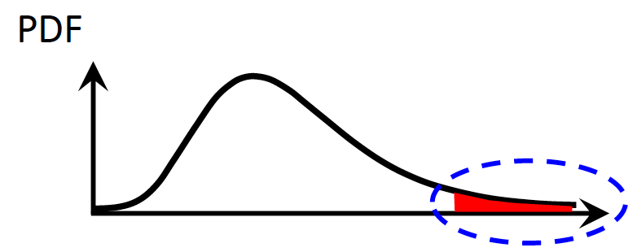
Energy Harvester – Optimization
Electromechanical system
Mean harvested power
Ultimate goal: Maximize output
Additional design criteria
Prevent mechanical failure
Safeguard electrical equipment
Space limitations
Optimum design problem
Find that maximize
Subject to:
Constraint on failure probability
Response PDF accuracy at the tails
Commonly used statistical linearization treatment PDF inaccurate at the tails

Slide 9
Outline
Introduction
Vibration Energy Harvesting
Modelling aspects
Optimization
Wiener path integral (WPI) technique
Standard formulation
Modification
Numerical Results
Conclusions

Slide 10
WPI technique - Standard formulation
Wiener path integral (WPI) Wiener (1921), Feynman (1948)
Transition probability density
State Space
.
.
.
Lagrangian functional
Determine by solving:
Variational problem
Euler-Lagrange equations
minimize
Rayleigh-Ritz direct method

Slide 11
WPI technique - Extension
Governing equations
white noise process
Mechanical oscillator
- Underdetermined SDE
singular
Electrical circuit
- Constraint
Constrained variational problem
minimize
subject to

Slide 12
Constrained variational problem
WPI technique - Extension
minimize
subject to
Rayleigh-Ritz method and nullspace approach
Expansion in a polynomial basis:
Functional : function of
minimize
Constraint: polynomial function of , linear in
Euler-Lagrange equations and Lagrange multipliers
Unconstrained variational problem
Lagrange multiplier
minimize
where

Slide 13
Outline
Introduction
Vibration Energy Harvesting
Modelling aspects
Optimization
Wiener path integral (WPI) technique
Standard formulation
Modification
Numerical Results
Conclusions

Slide 14
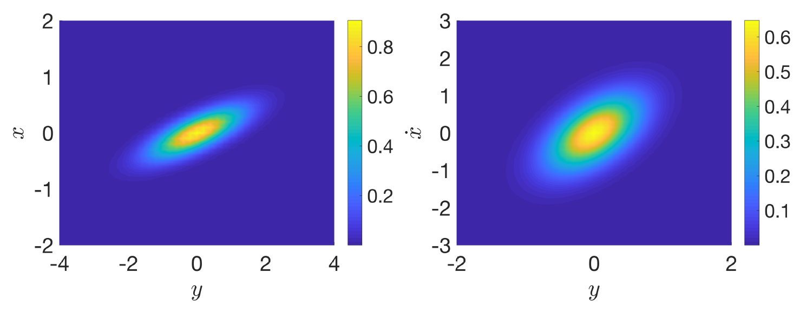
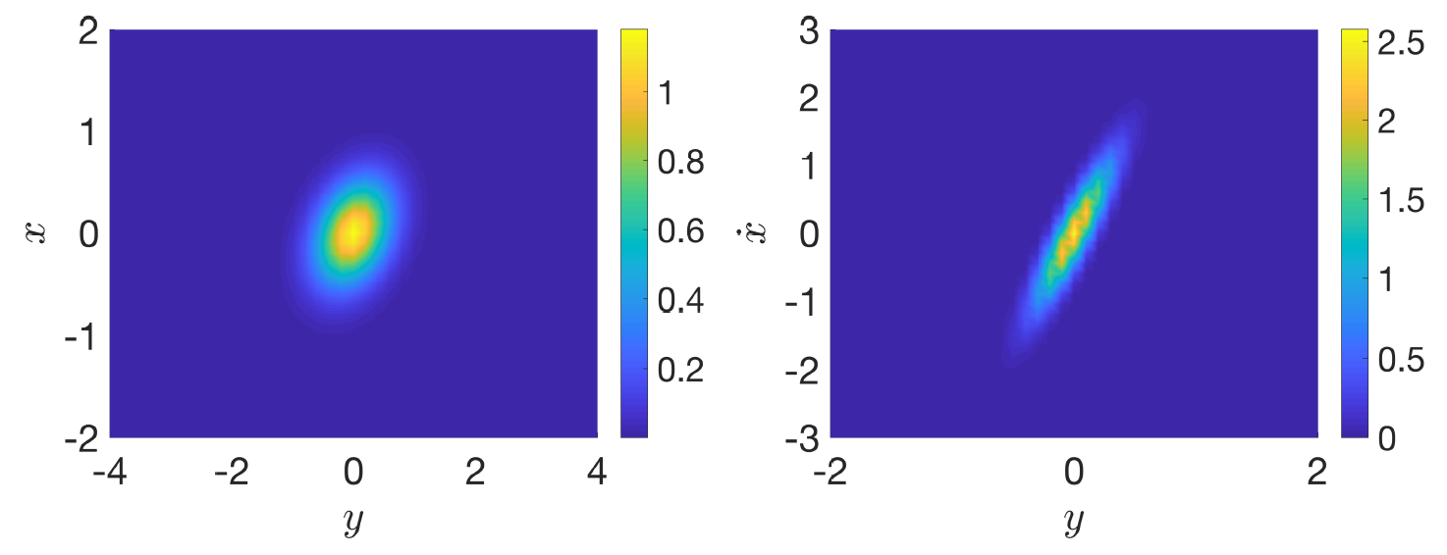
Numerical results
Transition PDF
Stationary joint response PDF
Linear Harvester

Slide 15
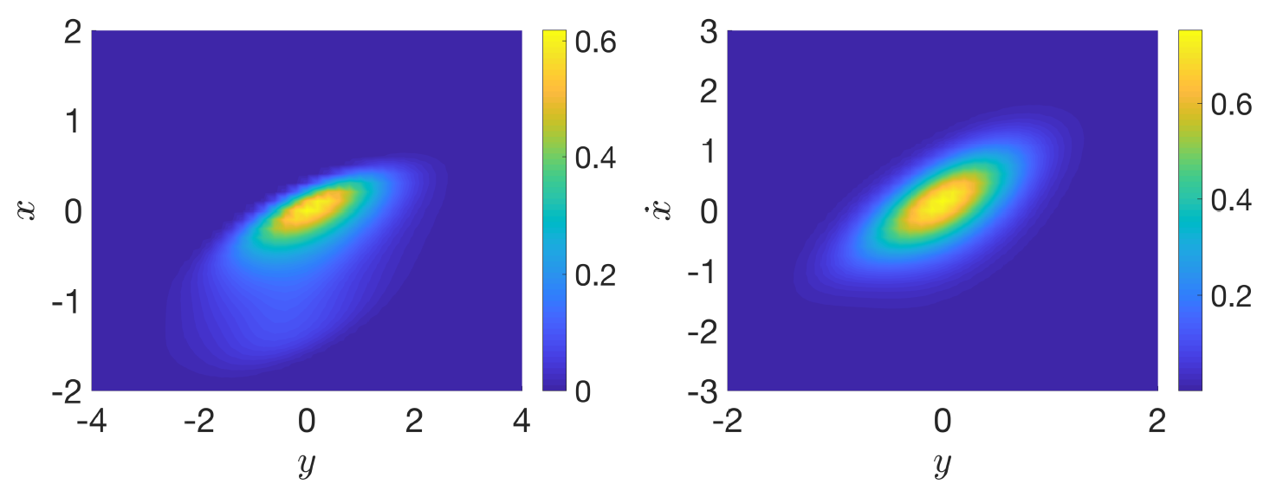
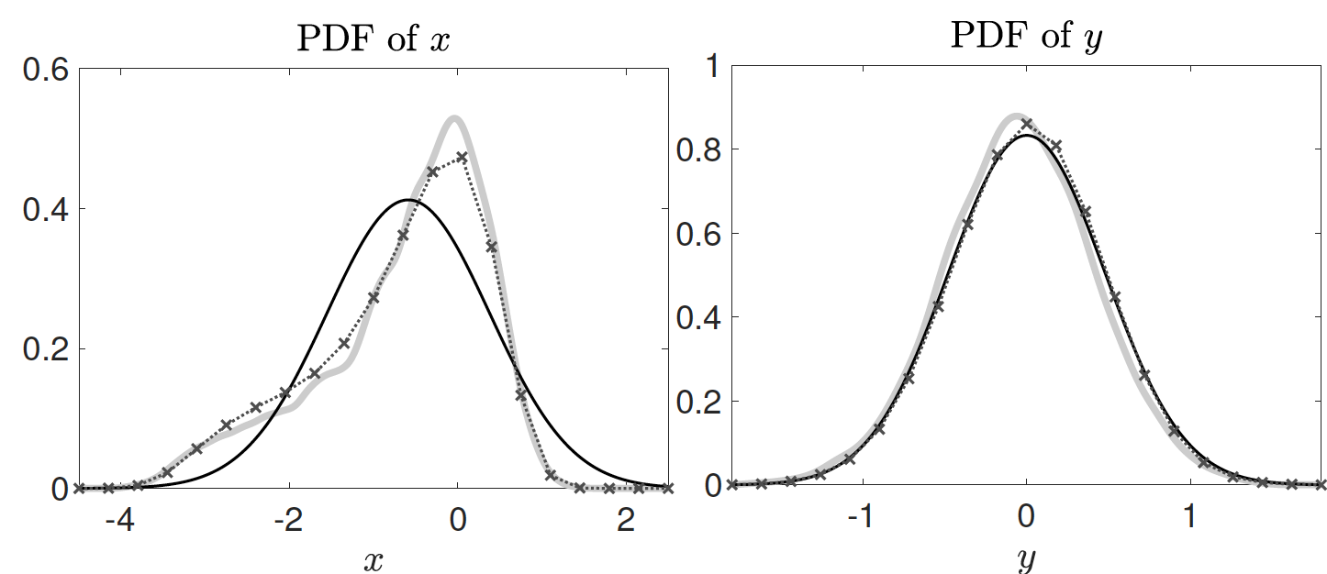
Numerical results
Nonlinear harvester
Statistical linearization: inaccurate probability of failure
MCS
statistical linearization
WPI

Slide 16
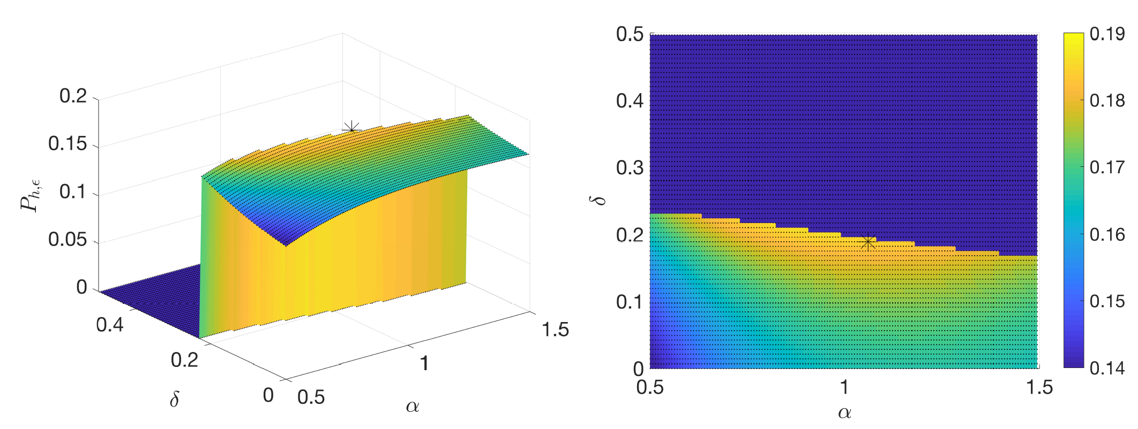
Numerical results – Optimum design
Design of nonlinear energy harvester for maximum mean harvested power and constrained probability of failure.
This is
Full grid using statistical linearization: 10296 objective function evaluations

Slide 17
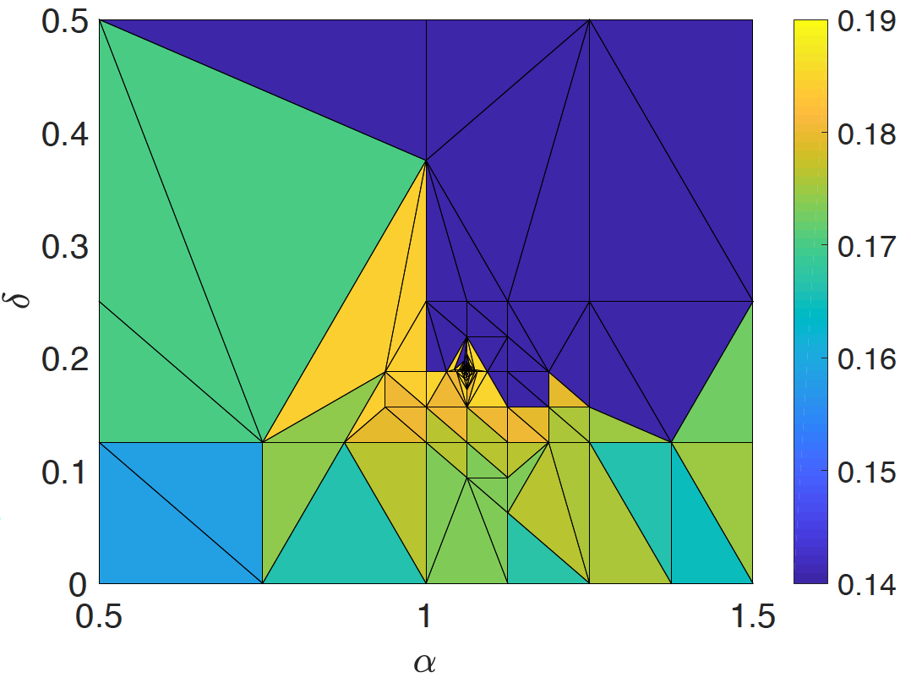
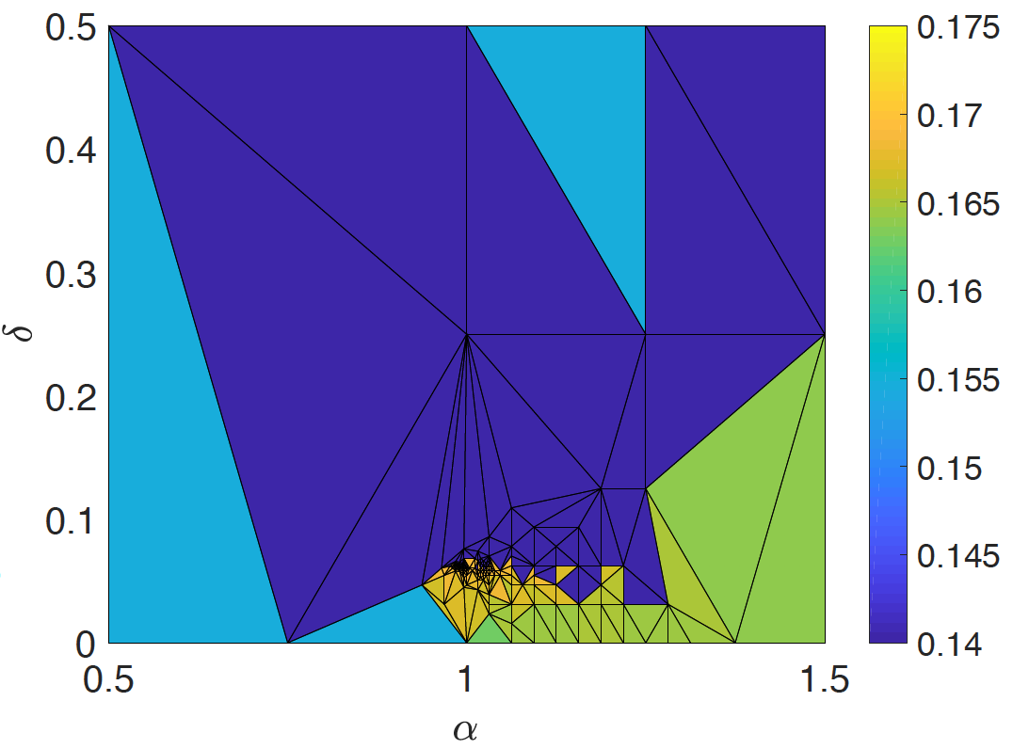
Numerical results – Optimum design
Gradient-free optimization algorithm: Generalized Pattern Search (GPS)
statistical linearization: 164 evaluations
WPI technique: 144 evaluations

Slide 18
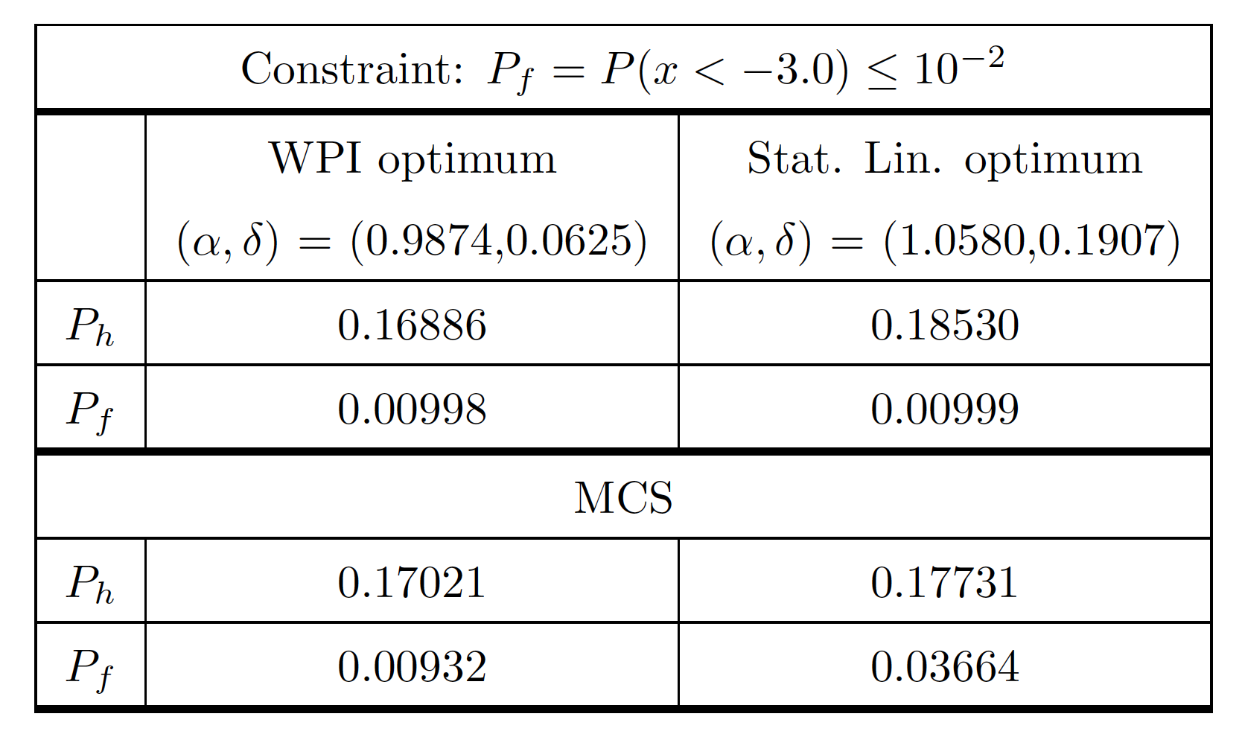
Numerical results – Optimum design
Assessment of optimum designs using Monte-Carlo Simulation (50000 realizations)
constraint violation

Slide 19
Outline
Introduction
Vibration Energy Harvesting
Modelling aspects
Optimization
Wiener path integral (WPI) technique
Standard formulation
Modification
Numerical Results
Conclusions

Slide 20
Conclusions
Path integral technique modification to enable the analysis of vibratory energy harvesters
Formulation of constrained variational problem
E-L equations and Lagrange multipliers Calculus of Variations
Rayleigh-Ritz and nullspace computationally efficienrt
Efficient computational scheme for accurate determination of response PDF
Design optimization for maximum output and constrained probability of failure
MCS
Path integral significantly outperforms a commonly utilized statistical linearization solution treatment
statistical linearization
Statistical linearization based (constrained ) optimum design yields either sub-optimal solutions, or solutions that violate the constraint.
WPI

Slide 21
Thank you!

